Slide 1


Slide 2
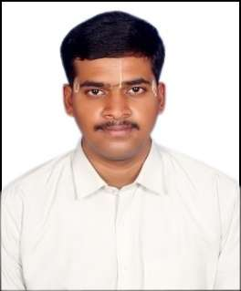
Project Highlights
Project Name : Domino’s Automation
Team Size : 1
BU Mentor Name : Mentor PS#
Team Members Details (Professional Stamp Size Photo with few lines of individual briefing
A Prasanna
99002523
2009MYSEMB02
BE ( CS )
Problem-solving

Slide 3
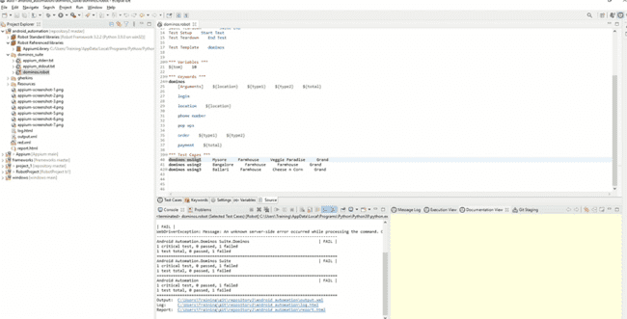
Project Video Snippet

Slide 4
Future development that can be implemented further
We can continue the automation by ordering contents of cart and then paying the amount fully to the processing.

Slide 5


Thank You !

